Slide 1
Diverticular Disease
Brittany Thompson PA-C

Slide 2
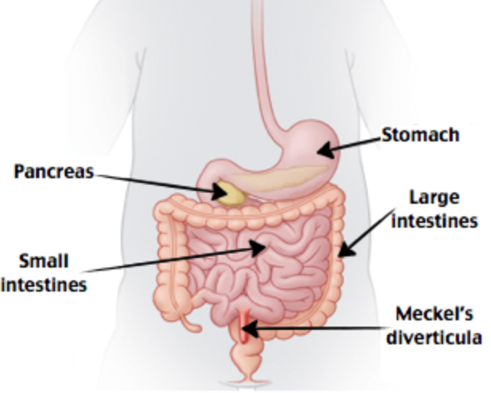
Meckel’s Diverticulum
Before we jump into colonic diverticular disease, just a quick reminder about….
congenital “true” diverticulum of all three small bowel layers that arises from the antimesenteric surface of the mid-to-distal ileum
Rule of 2’s:
2” long
2 feet from the ileocecal valve
2% of the population
2% of those patient develop complications
2 years of age
2:1 Male to female ratio

Slide 3
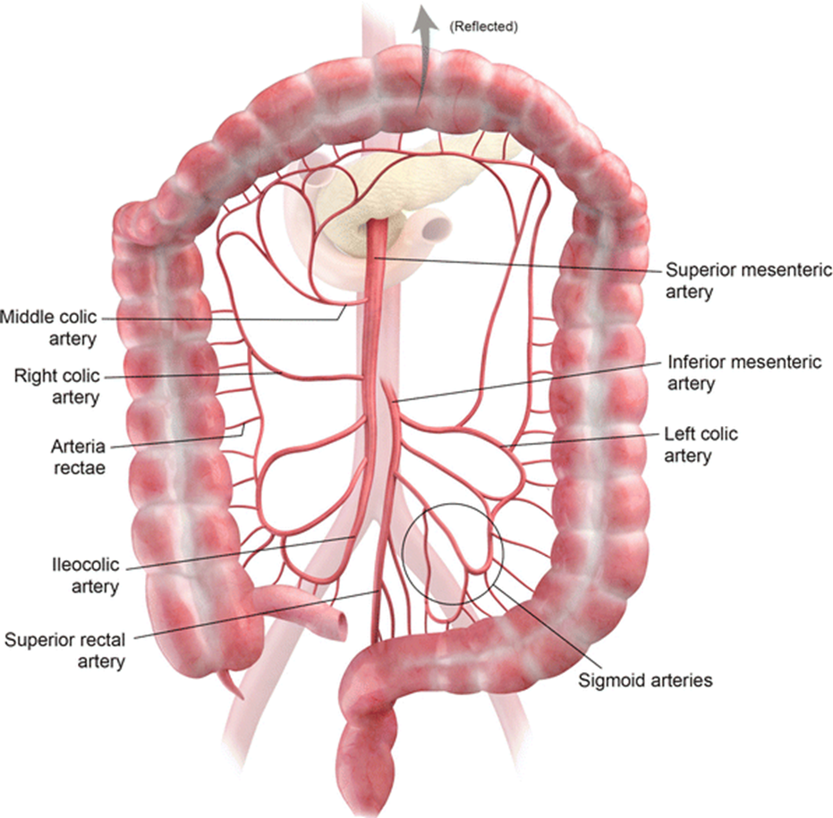
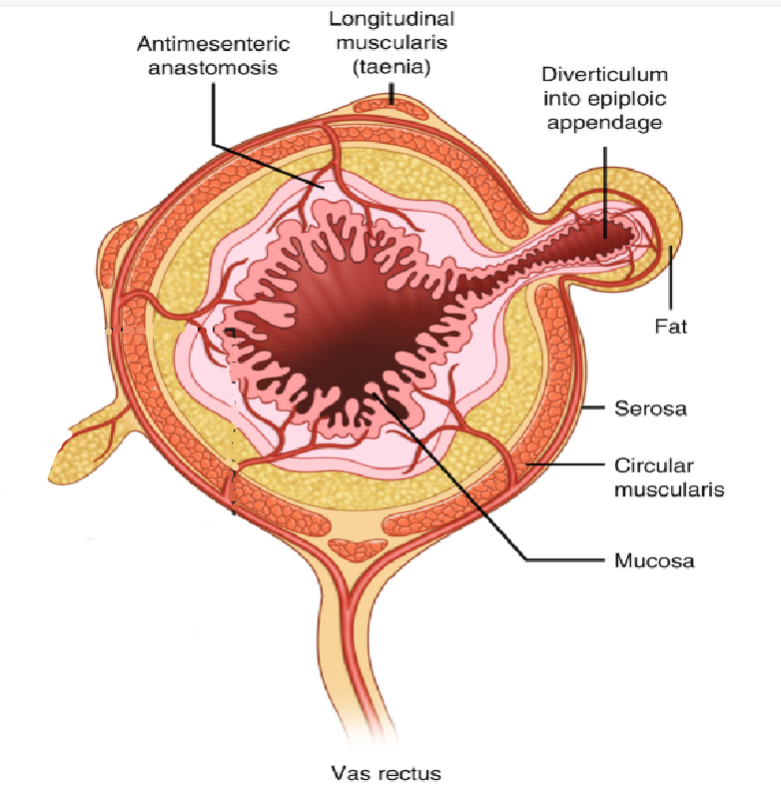
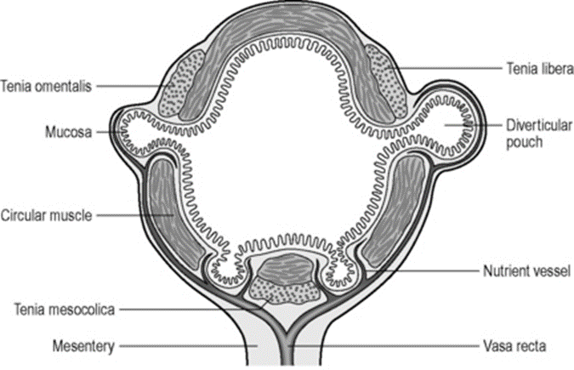
Colon Anatomy
Layers of Colon wall:
-Mucosa
-Submucosa
-Muscularis Propria
-Vas Rectus blood supply
-Serosa
Blood Supply:
Superior Mesenteric Artery
  Ileocolic, right colic, middle colic
Inferior Mesenteric Artery
  left colic, sigmoid, superior rectal

Slide 4
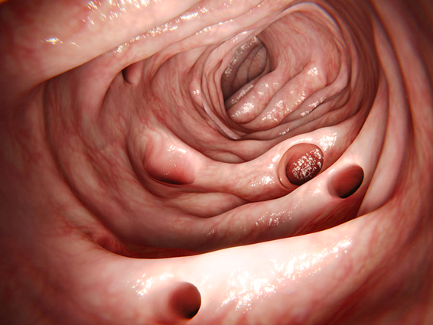
Diverticulosis: asymptomatic colonic outpouchings
“False” Diverticula
anti-mesenteric side
areas of colonic weakness where vasa recta penetrate through muscularis circularis
thin walled: only covered with mucosa and submucosa layers

Slide 5
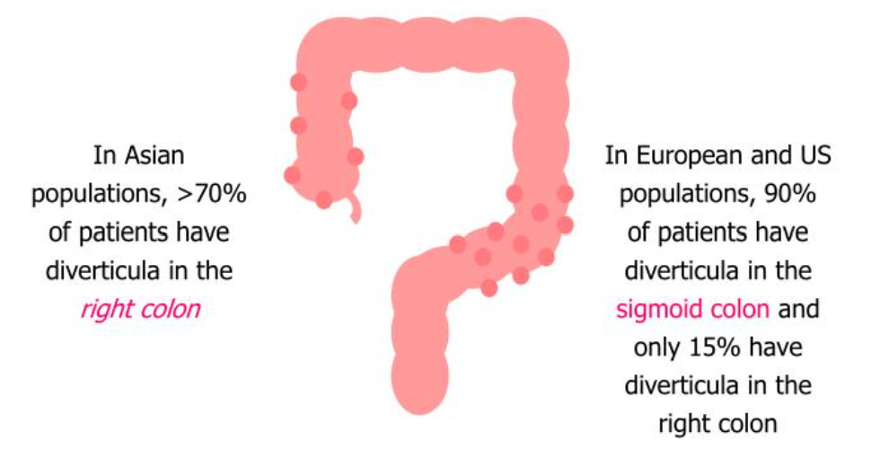
Diverticular Disease
Epidemiology
Incidence increases with age
Western Diet (low fiber, high red meat)
  Most commonly seen in the sigmoid colon
Physical inactivity
Male > Female
Obesity / elevated BMI
Smoking
Long term NSAIDs/Opioids use

Slide 6
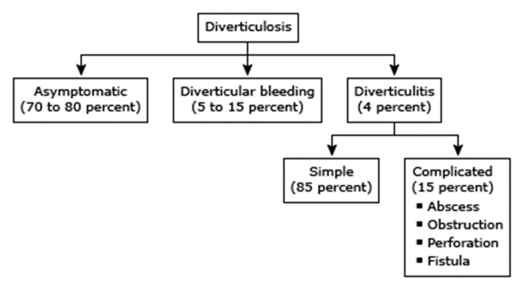
Diagnosing Diverticulitis
Signs and Symptoms
LLQ abdominal pain
Nausea/Vomiting
Fever
Anorexia
Constipation
Rectal Bleeding
Labs and imaging
Leukocytosis
CT Abdomen/Pelvis with IV contrast

Slide 7
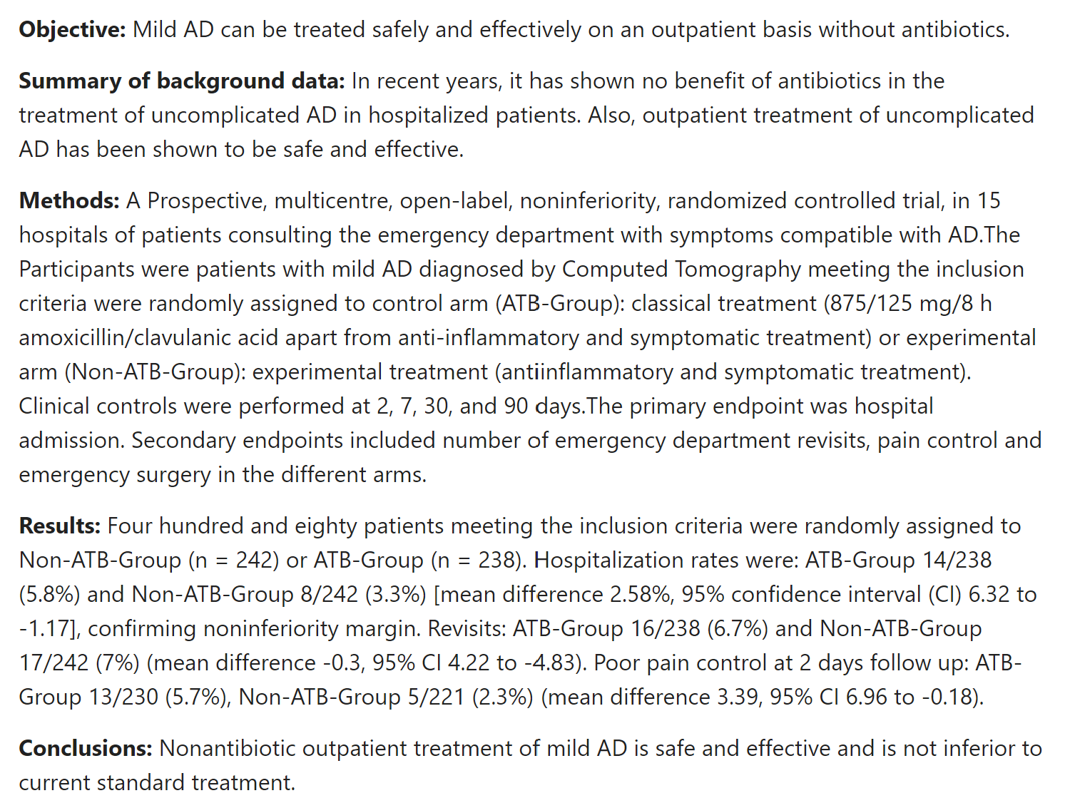
Outpatient Management
DINAMO trial
Simple uncomplicated diverticulitis without:
Sepsis/SIRS
    Tachycardia, WBC >12 or <4 , Temp >38, Tachypnea
Severe abdominal pain/peritonitis
Micro perforation
Age >70
Immunosuppressed
Significant comorbidities
Inability to tolerate PO intake
Already failed attempted outpatient trial
For patients who meet criteria for outpatient treatment of acute colonic diverticulitis, evidence is now suggesting to NOT administer antibiotics. These patients should have close outpatient follow up, but do not require repeat imaging to confirm resolution.

Slide 8
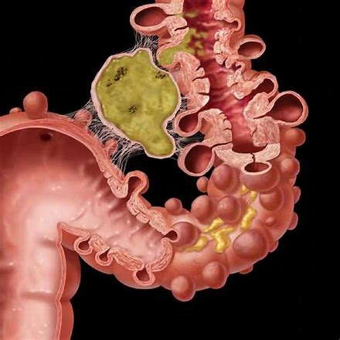
General Inpatient Management
Serial abdominal exams
NPO w/ IV fluids
Pain control
Trend leukocytosis
Blood cultures
6 week outpatient follow up for colonoscopy
IV antibiotics: Gram – and Anaerobic coverage
  Zosyn 3.375mg IV q 6 hours
  or
  Ceftriaxone 2G IV daily & Metronidazole 500mg IV q 8 hours

Slide 9
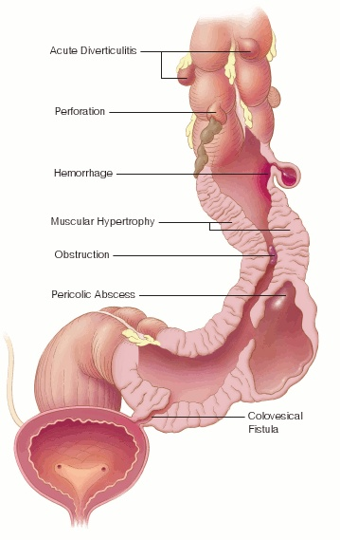
Complicated Diverticulitis
Perforation
Obstruction/Stricture
Abscess
Fistula
Sepsis and peritonitis
Recurrent episodes
Cancer

Slide 10
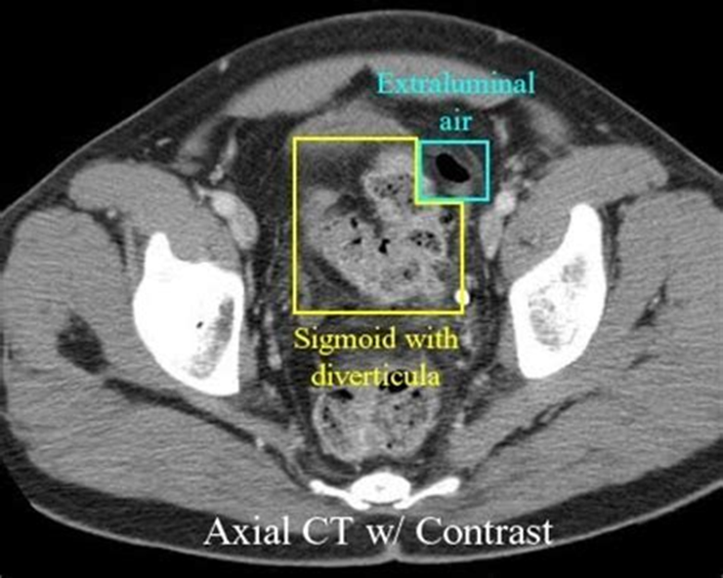
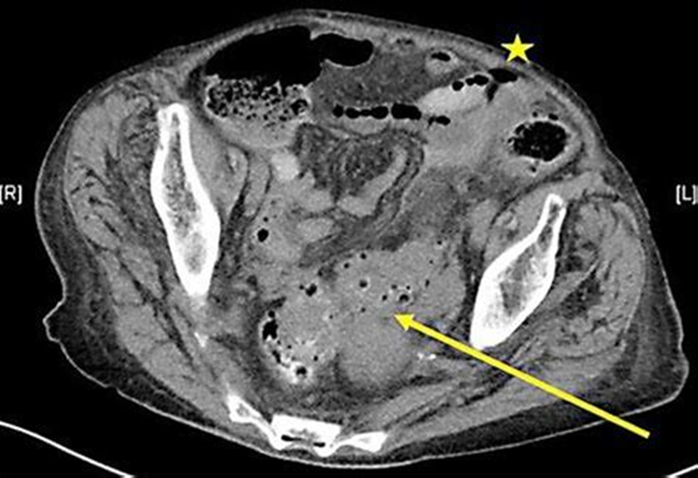
Perforation
Micro perforation
few peri colonic extraluminal air bubbles
localized abdominal pain on exam.
treat with IV antibiotics similar to abscess
Free-Air
Diffuse and distant pneumoperitoneum (extraluminal air)
Peritonitis OR potentially localized pain with palpation
Abdominal exam determines:
  immediate surgical intervention vs. antibiotics and repeat imaging

Slide 11
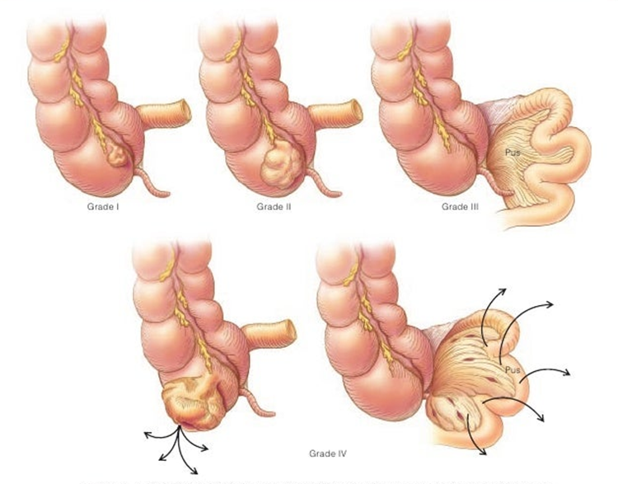
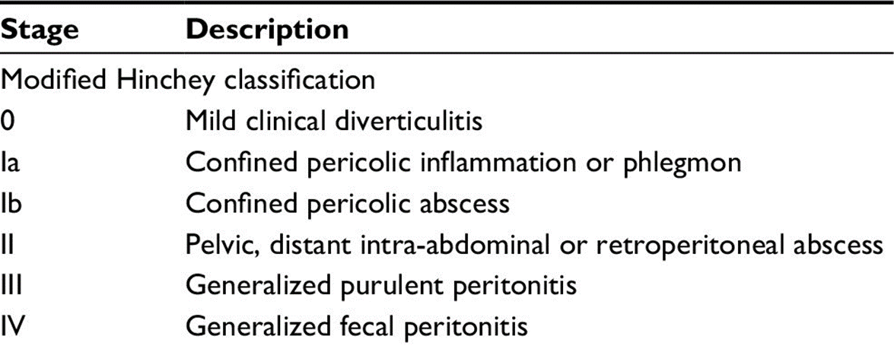
Abscess:
< 3cm IV antibiotics and observe
> 3cm IV antibiotics with IR drainage and/or surgical washout

Slide 12
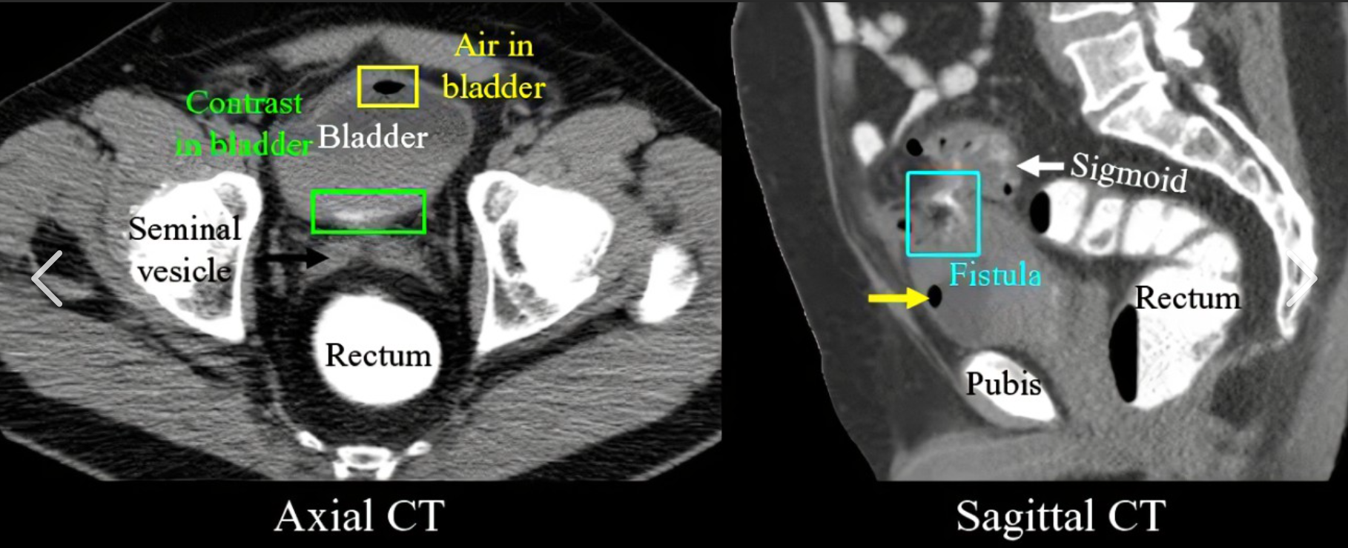
Fistula:abnormal passage forming between the bowel and nearby organs
1. Colovesicular
  Most common type of fistula
  Sx: Dysuria, recurrent UTI, pneumaturia, fecaluria
  Dx: CT w/PO or rectal contrast, cystoscopy, colonoscopy
2. Colovaginal
  Sx: Passage of gas or feces vaginally
  Dx: vaginal speculum exam or flexible sigmoidoscopy
3. Coloenteric
  Rare
  Sx: severe watery diarrhea, weight loss
4. Colouterine
Patients rarely require emergent surgical intervention for treatment of a fistula, therefore elective one-stage resection with primary anastomosis is typically the goal of care. Malignancy must also be ruled-out.

Slide 13
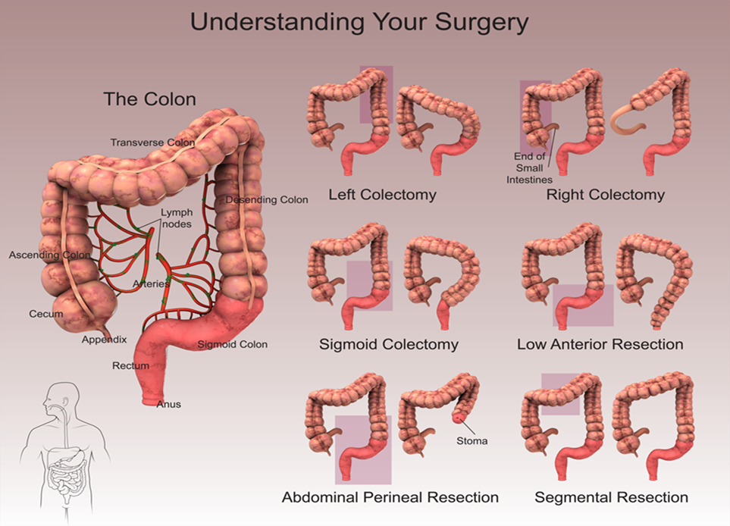
Approximately 15% of patients with diverticulitis will require surgical intervention.
Patient condition may change from initial presentation and could require surgical intervention at any time in their clinical course
Surgery Indications
Urgent
Hemodynamically unstable
Frank perforation and abscess (Hinchey III or IV)
Worsening pain
Increasing leukocytosis despite IV antibiotics and/or IR drainage
Bleeding
  Rare, but if unable to be controlled with endoscopic/IR attempts at hemostasis
Stricture/Obstruction
Non-Emergent
Fistula
Recurrent episodes diverticulitis
Suspected cancer
Surgical Intervention

Slide 14
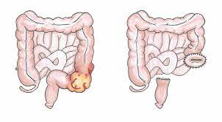
Hartmann’s Procedure
Rectosigmoid resection with stapled rectal stump and end colostomy
Utilized for frank perforations, contamination and abscess; typically indicated when primary anastomosis is contraindicated because of the peritoneal contamination.
Could be done as a staged procedure with DPR & temporary abdominal closure (Abthera)
Colostomy reversal and take-down may be considered months later
Subsequent closure of the colostomy is a technically difficult operation associated with high morbidity and mortality rates. As a result, colostomy closure is only performed in approximately 50 to 60 percent of all patients after a Hartmann's procedure

Slide 15
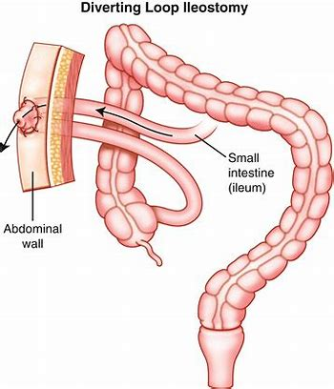
Primary anastomosis with proximal diversion (Loop ileostomy)
Considered if healthy appearing colon ends allow for anastomosis following resection of affected section of colon.
Trials show similar morbidity and mortality rates compared with Hartmann’s however these patients have a higher success rate with ostomy reversal later.
Reversal of loop ostomy is a simpler procedure with less complications and a shorter hospital stay/recovery period.

Slide 16
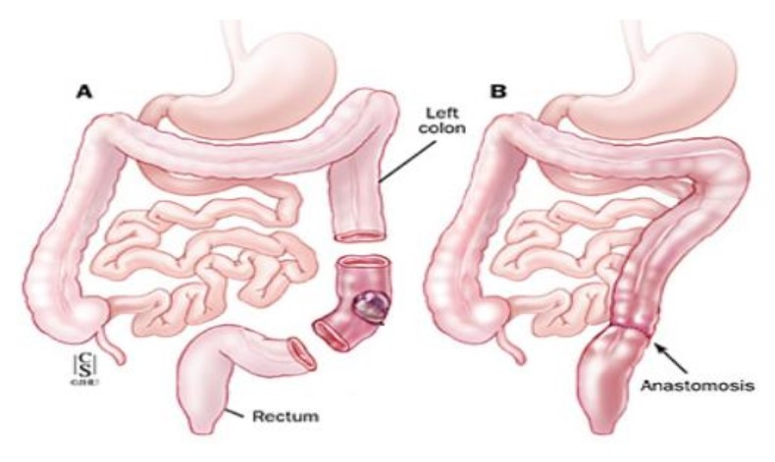
Colon Resection with primary anastomosis
The 2020 American Society of Colorectal Surgeons (ASCRS) guidelines recommend elective surgery to patients who had a prior episode of complicated diverticulitis and those who are immunosuppressed regardless of symptoms because such patients could develop serious complications or die from recurrent attacks of diverticulitis
May be done electively 8+ weeks after resolution of acute symptoms for recurrent/chronic diverticulitis
Considered if suspected cancer or stricture/obstruction
Most successful when no acute inflammation and when bowel can be prepped before hand.
Open, laparoscopic, or robotic

Slide 17
References
Pemberton, J. (2021, February 17). Acute Colonic Diverticulitis: Surgical Management . UpToDate. Retrieved July 10, 2022, from https://www.uptodate.com/contents/acute-colonic-diverticulitis-surgical-management?search=diverticulitis+treatment+&amp;source=search_result&amp;selectedTitle=2~150&amp;usage_type=default&amp;display_rank=2
Swanson SM, Strate LL. Acute Colonic Diverticulitis. Ann Intern Med. 2018 May 1;168(9):ITC65-ITC80. doi: 10.7326/AITC201805010. Erratum in: Ann Intern Med. 2020 May 5;172(9):640. PMID: 29710265; PMCID: PMC6430566.
Hanna MH, Kaiser AM. Update on the management of sigmoid diverticulitis. World J Gastroenterol. 2021 Mar 7;27(9):760-781. doi: 10.3748/wjg.v27.i9.760. PMID: 33727769; PMCID: PMC7941864.
Thompson AE. Diverticulosis and Diverticulitis. JAMA. 2016;316(10):1124. doi:10.1001/jama.2016.3592
Rezapour M, Ali S, Stollman N. Diverticular Disease: An Update on Pathogenesis and Management. Gut Liver. 2018 Mar 15;12(2):125-132. doi: 10.5009/gnl16552. PMID: 28494576; PMCID: PMC5832336.
Wheat CL, Strate LL. Trends in Hospitalization for Diverticulitis and Diverticular Bleeding in the United States From 2000 to 2010. Clin Gastroenterol Hepatol. 2016;14(1):96–103 e1.
Liu PH, Cao Y, Keeley BR, Tam I, Wu K, Strate LL, et al. Adherence to a Healthy Lifestyle is Associated With a Lower Risk of Diverticulitis among Men. Am J Gastroenterol. 2017;112(12):1868–76.
Mora-López L, Ruiz-Edo N, Estrada-Ferrer O, Piñana-Campón ML, Labró-Ciurans M, Escuder-Perez J, Sales-Mallafré R, Rebasa-Cladera P, Navarro-Soto S, Serra-Aracil X; DINAMO-study Group. Efficacy and Safety of Nonantibiotic Outpatient Treatment in Mild Acute Diverticulitis (DINAMO-study): A Multicentre, Randomised, Open-label, Noninferiority Trial. Ann Surg. 2021 Nov 1;274(5):e435-e442. doi: 10.1097/SLA.0000000000005031. PMID: 34183510.
Hall, J., Hardiman, K., Lee, S., Lightner, A., Stocchi, L., Paquette, I. M., Steele, S. R., & Feingold, D. L. (2020). The American Society of Colon and rectal surgeons clinical practice guidelines for the treatment of left-sided colonic diverticulitis. Diseases of the Colon & Rectum, 63(6), 728–747. https://doi.org/10.1097/dcr.0000000000001679
InformedHealth.org [Internet]. Cologne, Germany: Institute for Quality and Efficiency in Health Care (IQWiG); 2006-. Diverticular disease and diverticulitis: Surgery for diverticulitis and diverticular disease. 2018 May 17. Available from: https://www.ncbi.nlm.nih.gov/books/NBK506997/
Powerpoint revised by Brittany Thompson PA-C 7/2023. Final draft approved Dr. Nicholas Thiessen MD 7/2023.

